Slide 1

APBD – lecture 5
Async code
Transactions
Stored procedures

Slide 2
Avoid blocking calls
Generally our REST API should be designed to proces many requests simultaneously.
Asynchronous APIs allow a small pool of threads to handle thousands of concurrent requests by not waiting on blocking calls.
Rather than waiting on a long-running synchronous task to complete, the thread can work on another request.

Slide 3
Avoid blocking calls
A common performance problem in ASP.NET Core apps is blocking calls that could be asynchronous. Many synchronous blocking calls lead to Thread Pool starvation and degraded response times.

Slide 4
Avoid blocking calls
Do not:
Block asynchronous execution by calling Task.Wait or Task.Result.
Acquire locks in common code paths. ASP.NET Core apps are most performant when architected to run code in parallel.
Do:
Make hot code paths asynchronous.
Call data access, I/O, and long-running operations APIs asynchronously if an asynchronous API is available. Do not use Task.Run to make a synchronous API asynchronous.

Slide 5
Example of turning synchronous endpoint into an asynchronous one

Slide 6
Performance comparison of both endpoints

Slide 7
Transaction
A transaction is the smallest work unit that is executed in the database and transactions also meet the properties of the ACID
ACID (atomicity, consistency, isolation and durability). SQL Server can operate 3 different transactions modes, and these are:
Auto-commit transactions
Implicit transactions
Explicit transactions

Slide 8
Auto-commit transactions
The auto-commit transaction mode is the default transaction mode of the SQL Server. In this mode, each SQL statement is evaluated as a transaction by the storage engine.
In this context, if any SQL statement completes its execution successfully it is committed, and the data modification will become permanent in the database.
On the other hand, if any statement faces any error, it will be rolled back. In this transaction mode, we don’t try to manage transactions and all operations are managed by the SQL Server.

Slide 9
Implicit transactions
In the implicit transaction mode, SQL Server takes the responsibility for beginning the transactions implicitly but it waits for the commit or rollback commands from the user.
In the implicit transaction mode, the database objects involved in the transaction will remain locked until the commit or rollback commands are executed.
In order to use the implicit transaction mode, we need to set implicit transaction mode to ON. We can use the following syntax to enable or disable the implicit transaction mode.

Slide 10
Implicit transactions
The implicit transaction is a connection-level setting and we can set this setting when connecting to the SQL Server.

Slide 11
Explicit transaction
In the explicit transaction mode, we have to define the starting and ending points of the transactions.
It means that all transactions must start with the BEGIN TRANSACTION statement and end with either COMMIT TRANSACTION or ROLLBACK TRANSACTION statements.

Slide 12
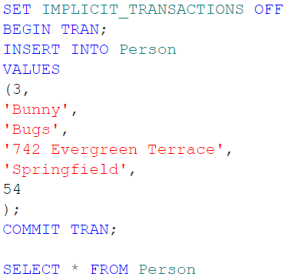
Explicit transaction

Slide 13
Transactions
Usually, when fulfilling any business process, we have multiple database operations we have to execute; for example, A single banking transaction can consist of numerous insert/update/delete statements.
We want to perform either all operations or none of them. If we execute only some of them, and then the exception will stop the execution – this can put our database into an inconsistent state.

Slide 14
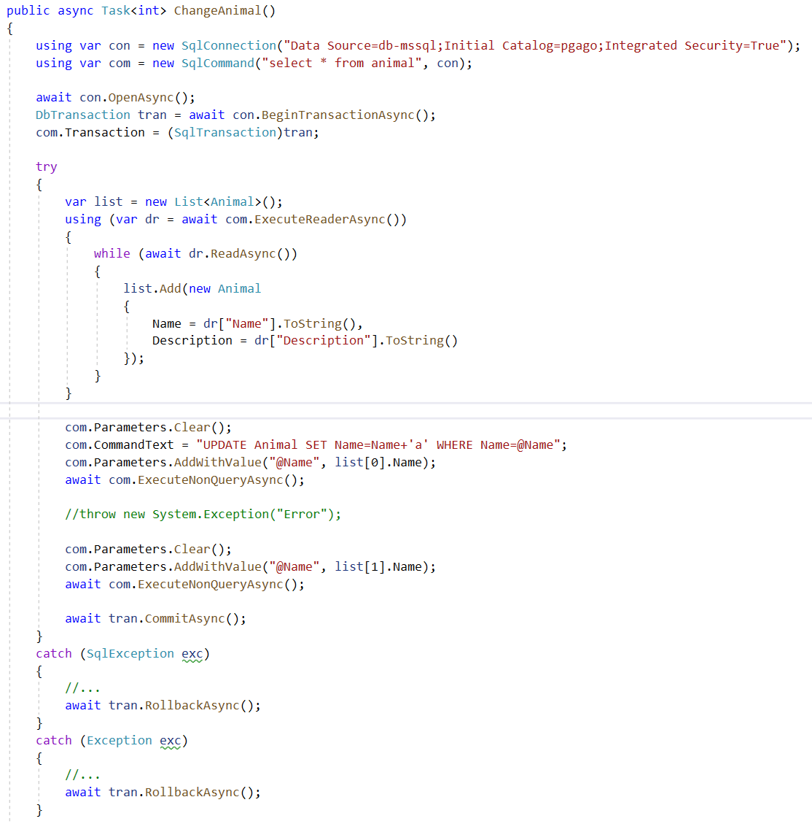
SqlTransaction

Slide 15
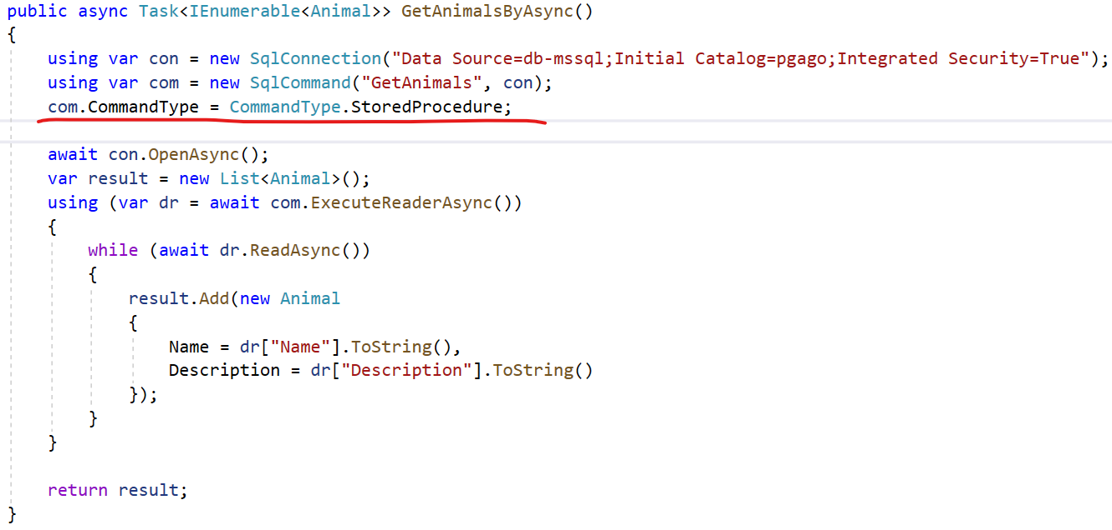
Using stored procedures

Slide 16
Pros of stored procedure
Performance benefits
Pre-parsed SQL
Pre-generated query execution plan
Reduced network latency
Potential cache benefits
Unless using the dynamic SQL – we are protected against SQL Injection
Allows us to control the access to db objects on very low level

Slide 17
Cons of stored procedures
Our code will become highly dependent on the exact database type we are using.
The business logic of our application may get scattered between different places – our code, and the database
Stored procedures are harder to version control
Our developers need to know the specific dialect of SQL
Stored procedures may become a problem when we want to use load balancing (especially master-master replication).

Slide 18
Pros of raw SQL approach
All the business logic is located within our code.
We can more easily version control the application.
By using specific additional libraries we can make our code more independent from the database we are using (we will see that in future classes).

Slide 19
Cons of raw SQL
Requires a lot of boilerplate code (unless we are using something more abstract than SqlConnection/SqlCommand).
Impedance mismatch problem
We have to remember about SQL injection

Slide 20
Bibliography
https://docs.microsoft.com/pl-pl/dotnet/csharp/programming-guide/concepts/async/
https://docs.microsoft.com/pl-pl/aspnet/core/performance/performance-best-practices?view=aspnetcore-5.0
https://www.plukasiewicz.net/Artykuly/SQL_Transactions
https://www.sqlshack.com/modes-of-transactions-in-sql-server/

